Slide 1


Railroad-Related Casualties in the United States in 2014
Roberto Reyes
EC591 Data Mining Tools

Slide 2
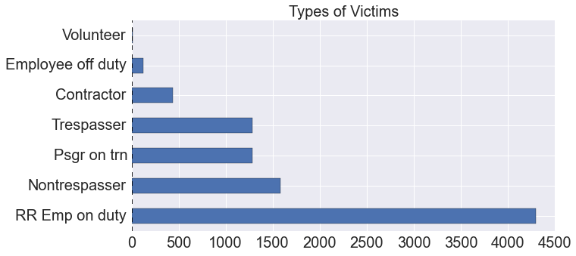
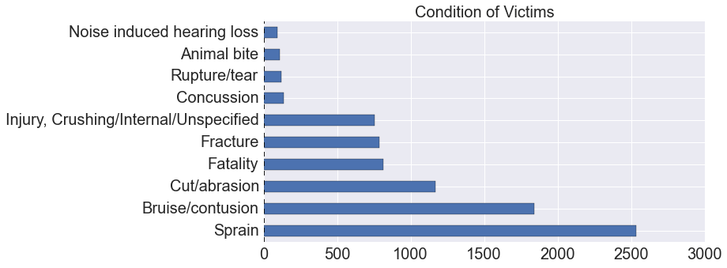
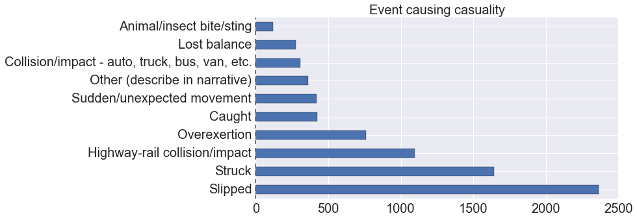
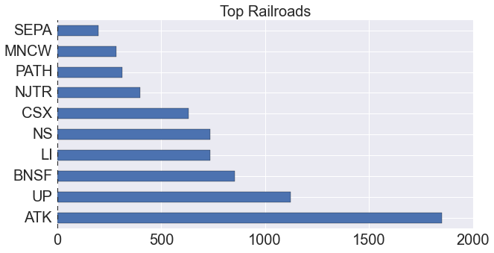

Slide 3
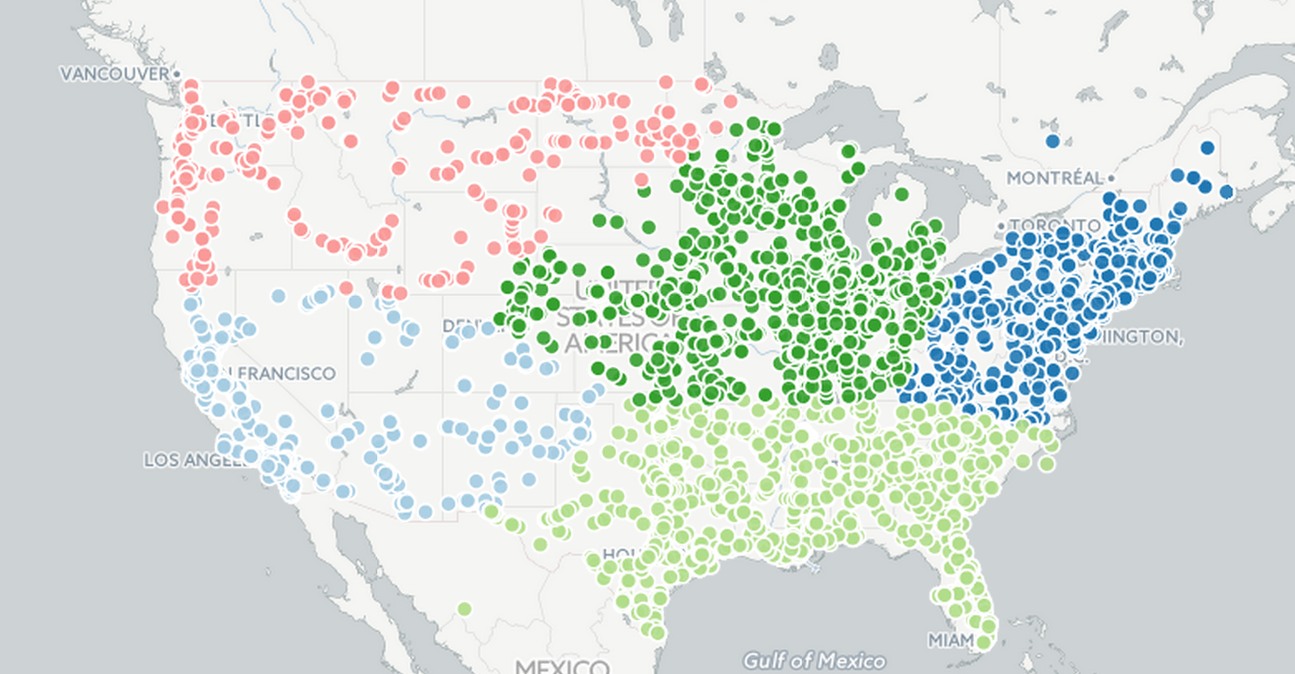
All Incidents

Slide 4
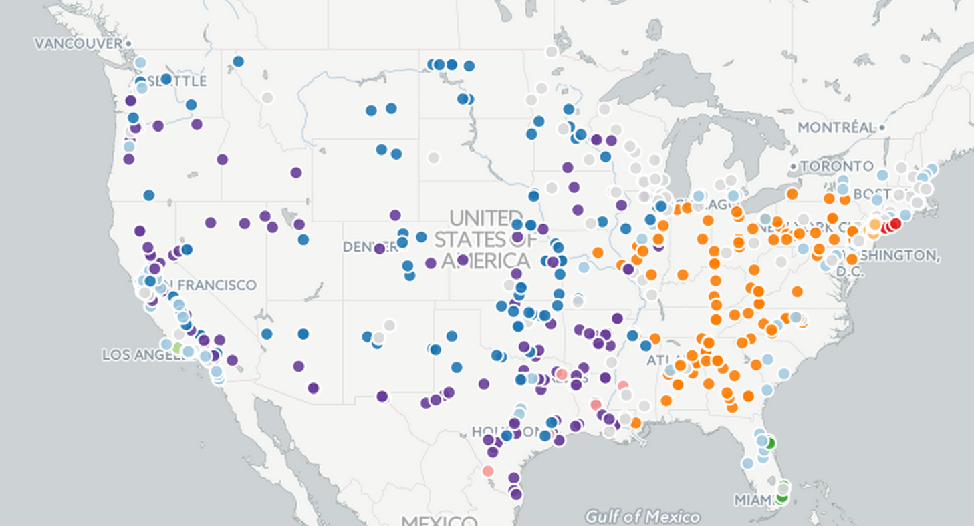
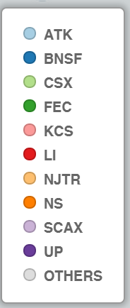
Fatalities

Slide 5
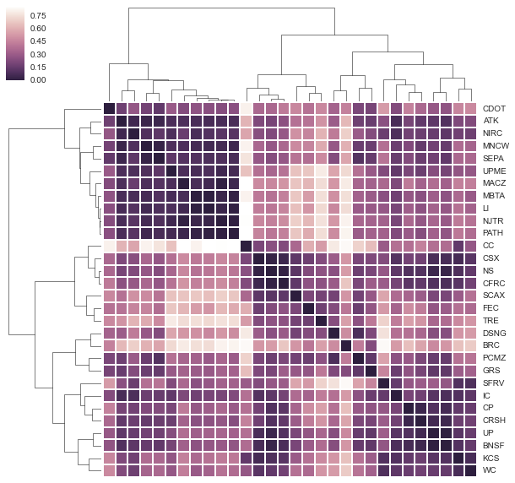
Hypothesis 1: Link Between Populous Locations and Casualities
SEPA - Philadelphia,
MBTA - Boston,
LI- Long Island,
NJTR - New Jersey Transit
PATH - New Jersey - NYC
ATK - Amtrak
MNCW - Metronorth - NYC-> CT
MACZ - Maryland -> DC
NIRC (northern illinoi)
UPMC - Chicago and outlying areas

Slide 6
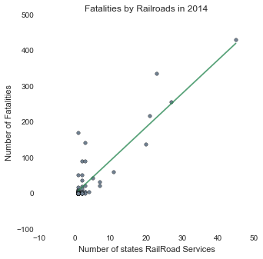
Hypothesis 2: Trans-state railroads are more likely to result in casualites
R-squared = 0.796

Slide 7
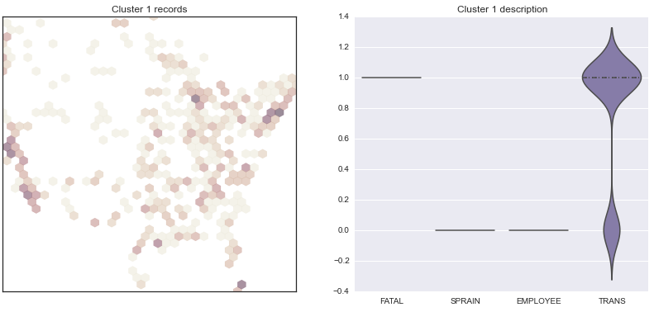
Hypothesis 2: Trans-state railroads are more likely to result in casualites

Slide 8
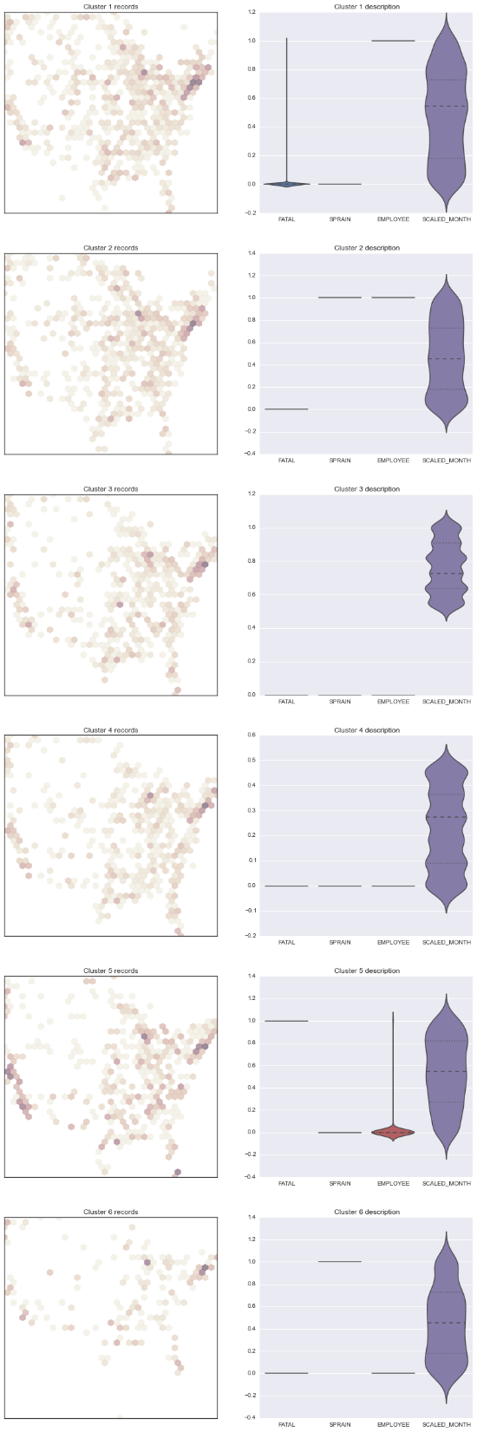
Hypothesis 3: Temporal related casualties

Slide 9
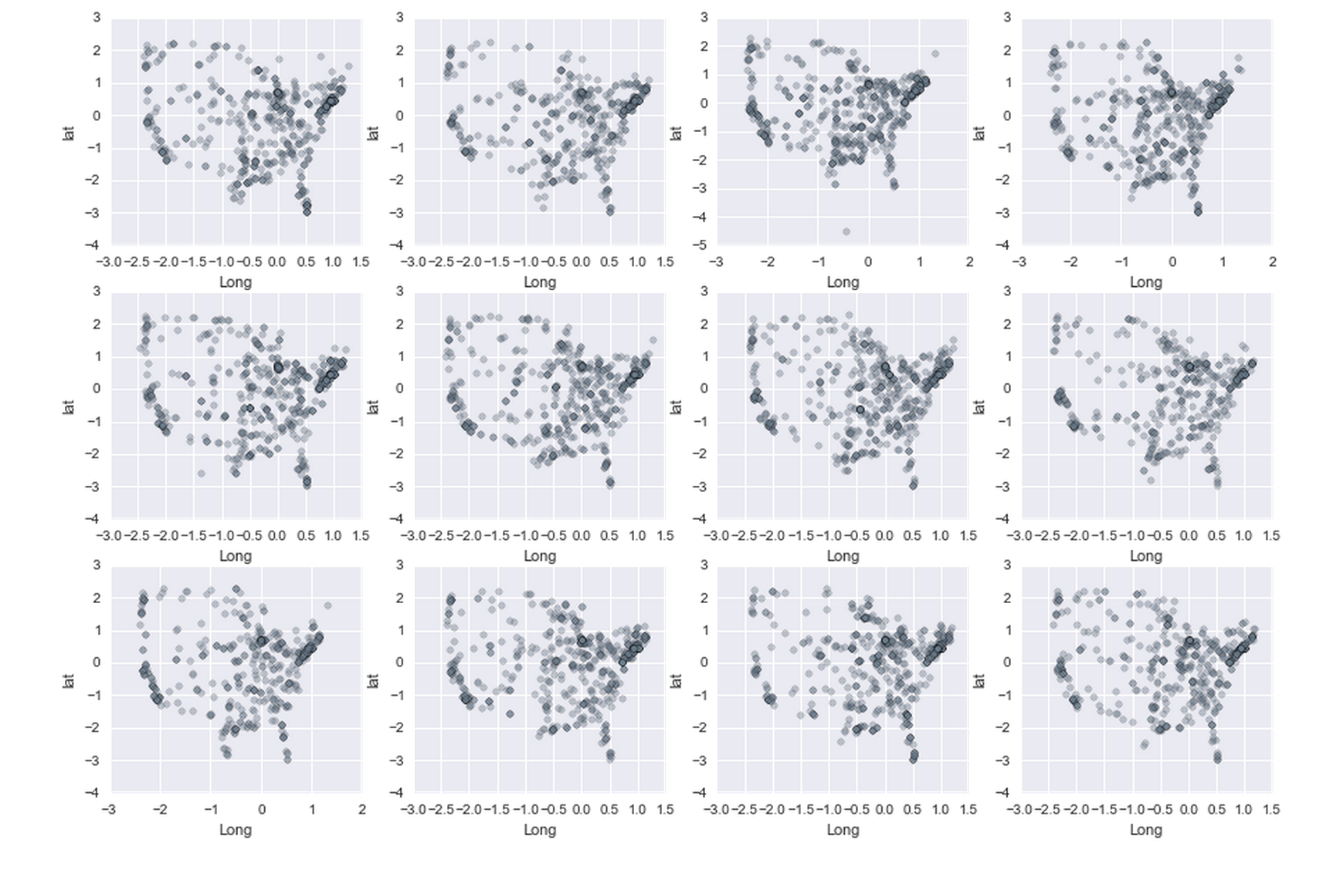
Hypothesis 3: Temporal related casualties

Slide 10


Low-Dimensional Data
Trains vs Casualty Type
Trains vs Event/ Cause

